Slide 1





Military strategy simulation
Using battle royal optimization algorithm
Nabila Ahmed 221106674 AIS
Samira Samir 221101769 AIS
Shahd Gawad A20000476 AIE
Maryam Eslam 221100500 AIS
Hager Mohamed 221101420 AIE

Slide 2


Agenda
01
04
Abstract
Developed Algorithm
02
Aim of project
03
Formulation
05
Experimentation
06
Conclusion

Slide 3

01
Abstract

Slide 4


INTRODUCTION
Battle royal optimization algorithm (BRO) is a population-based algorithm that simulates soldiers/players moving towards the safest place to survive. The BRO algorithm represents a paradigm shift in military strategy by introducing the concept of safe and danger zones. By creating specific circles where battles are concentrated, this algorithm optimizes resource allocation, reduces casualties, and enhances operational success.

Slide 5

02
Aim of project

Slide 6


The objective of this project is to develop a sophisticated military simulation that enables strategic planning and allows for the evaluation of outcomes before executing any actions in actual warfare.

Slide 7

The simulation IDE used: Visual studio code Programming language: C# Simulation developer: Unity

Slide 8
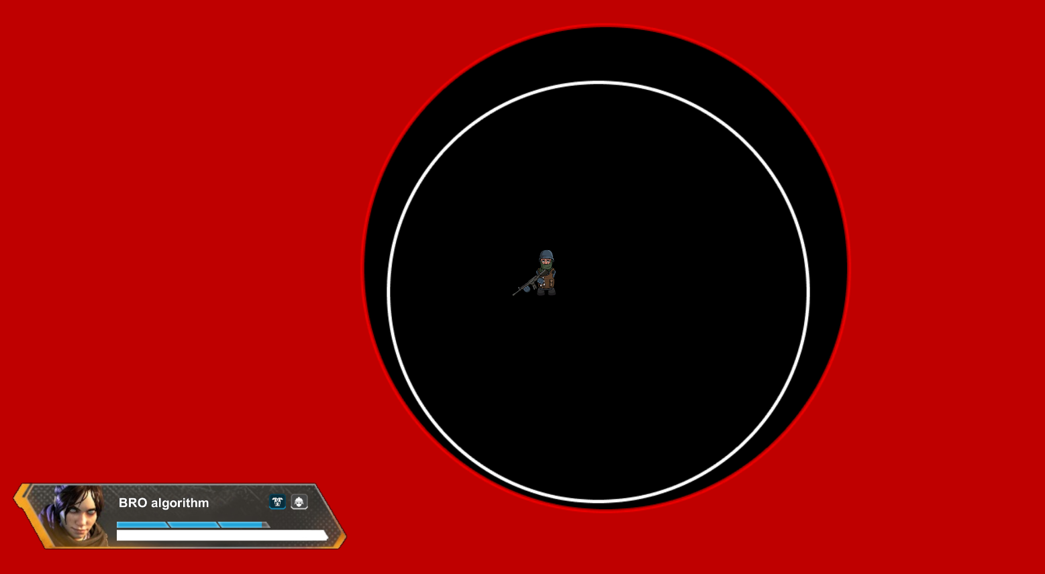

Slide 9
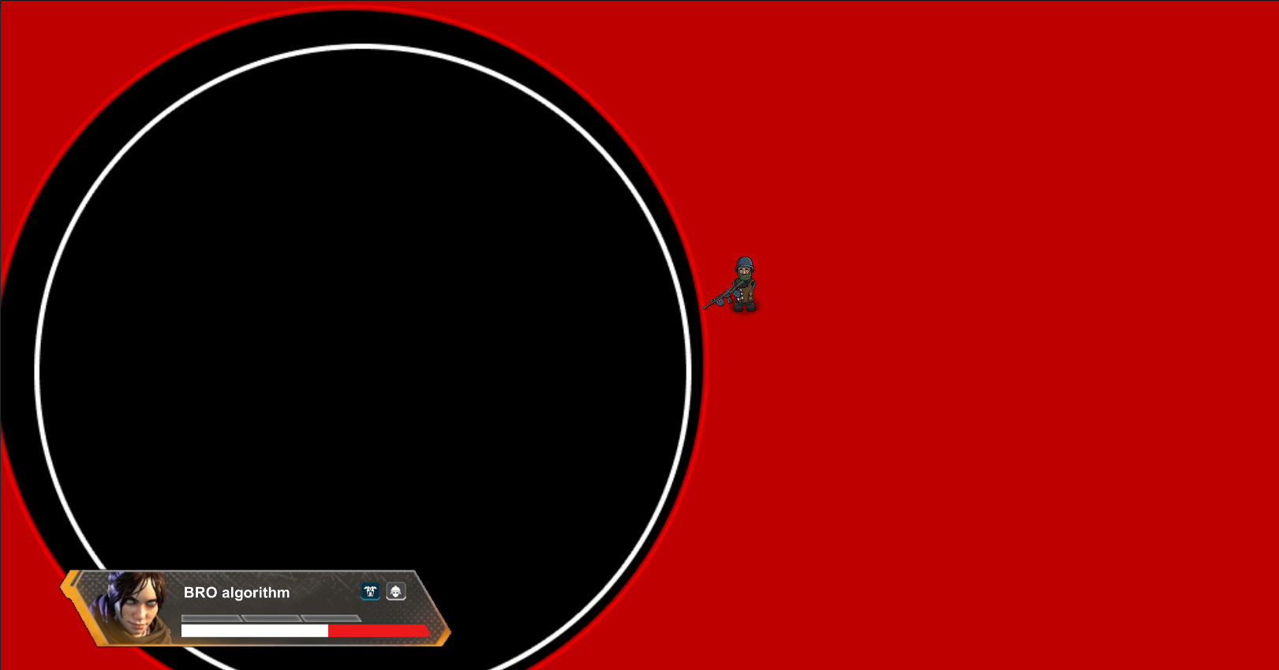

Slide 10

03
Formulation

Slide 11
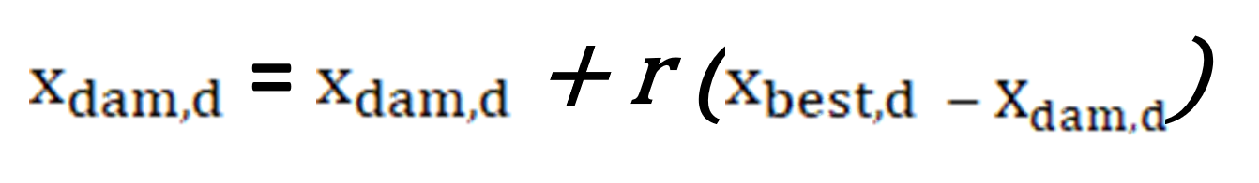

Formulation of the problem
Equ. 1
The equation provided is a key component for updating the velocity of a particle in a specific dimension of the search space.

Slide 12
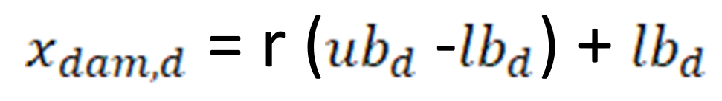
Formulation of the problem
Equ. 2
The equation calculates the value of a new candidate solution for the d-th dimension of the search space.

Slide 13
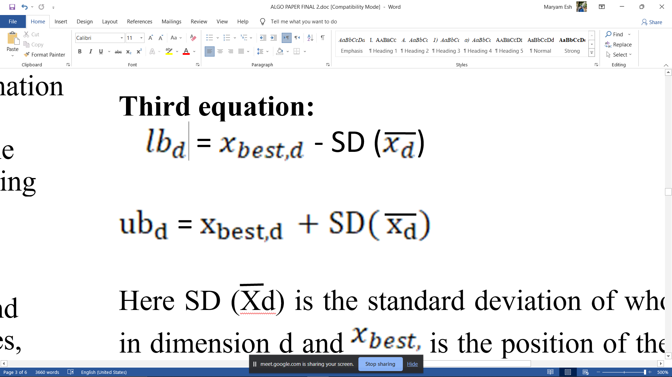
Formulation of the problem
Equ. 3
The purpose of this equation is to adjust the position of the best solution found so far based on the standard deviation of the population, ensuring that it remains within the original bounds and prioritizing the best player/soldier found in each iteration as an elite.

Slide 14

Developed algorithm
04

Slide 15
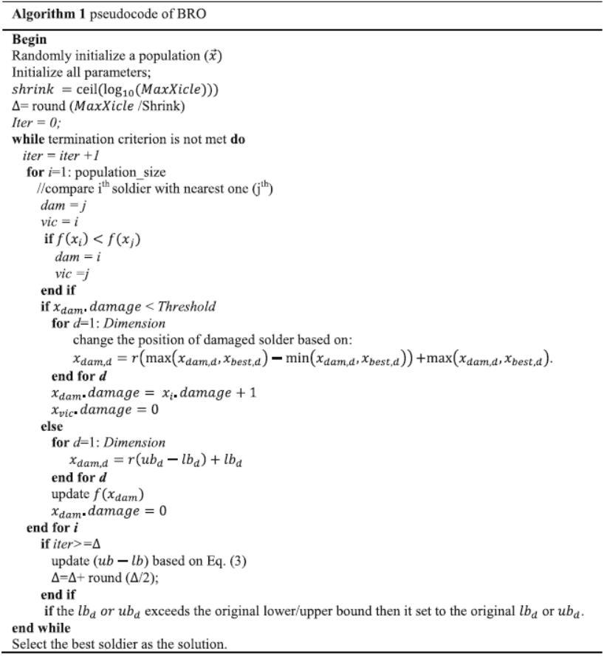
Pseudo code

Slide 16
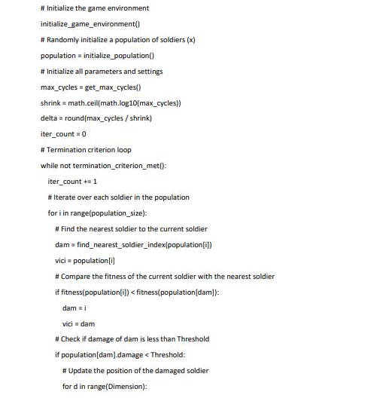
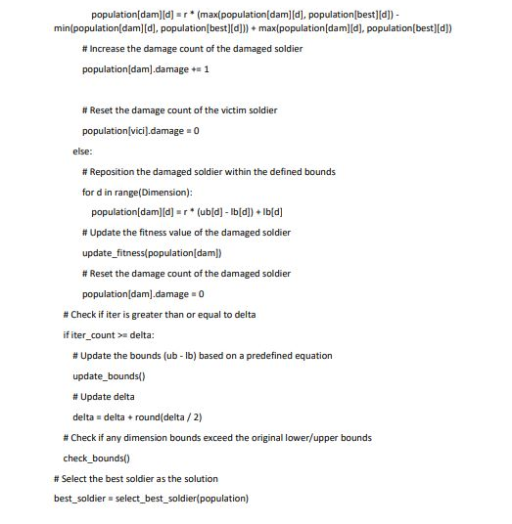
Enhanced Pseudo code

Slide 17

05
Experimentation

Slide 18
Implementation environment
Programming Language: Python and c# for unity simulation
Libraries and Frameworks: pandas , random and numpy
Development Tools: Integrated Development Environment (IDE) such as PyCharm and visual studio code

Slide 19
Dataset Details
my_result | my_score | points | opponent_score
Victory | 3 | 31 | 0
Defeat | 0 | -25 | 1
Victory | 1 | 31 | 0
Defeat | 0 | -25 | 1
Victory | 2 | 30 | 1
Draw | 1 | 0 | 1
Defeat | 0 | -24 | 3
Victory | 1 | 30 | 0
Defeat | 0 | -24 | 1
Iteration:100
population: 500
Number of Attributes: 4 (my_result, my_score, points, opponent_score)

Slide 20
Metrics
The fitness value represents the quality or performance of an individual solution in the BRO algorithm. The fitness is calculated based on the selected indices (individual) and is determined by the score difference between "my_scores" and "opponent_scores" for each corresponding index. Higher fitness values indicate better solutions. The code calculates the fitness for each individual in the population and updates the fitness values based on certain conditions during the algorithm's execution.

Slide 21
Conclusion and results
06

Slide 22


THANKS!

